Slide 1
Real time recompilation of running JavaScript
Peter van der Zee
FronteersConf 2013

Slide 2
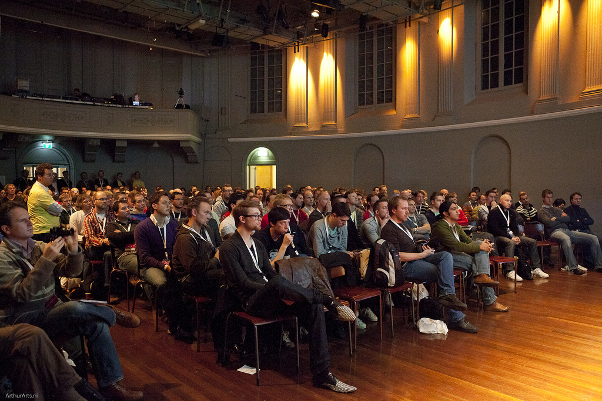

Slide 4
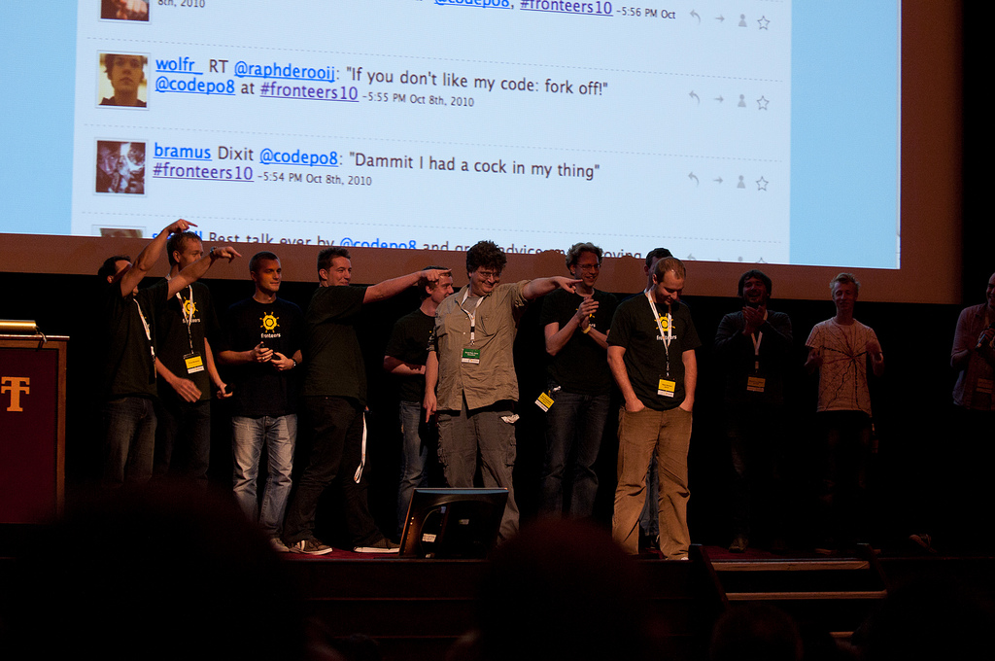

Slide 5
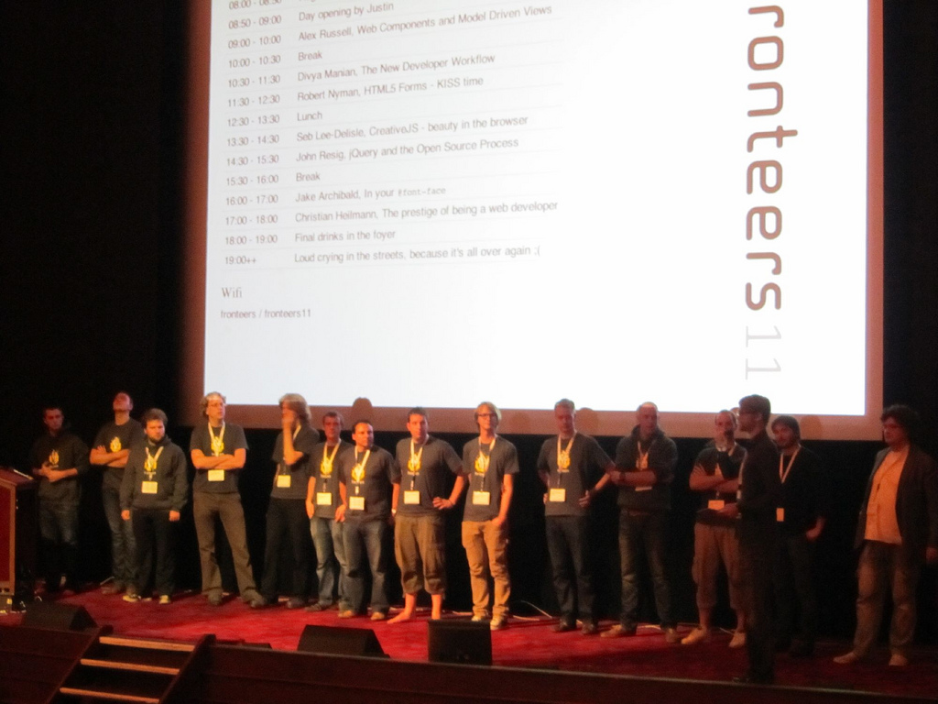

Slide 6
?

Slide 7
Whois
Peter van der Zee
JavaScript developer
Netherlands
qfox.nl
@kuvos
surfly.com
"Remote desktop in the browser"
JS1K
ZeonJS
ZeParser
HeatFiler

Slide 8

Demonstration

Slide 9
So...
Compile JS on the fly
Maintain access to closures
No restart of app required
Lazy evaluation
Generic approach

Slide 10

Live coding woohoo

Slide 11
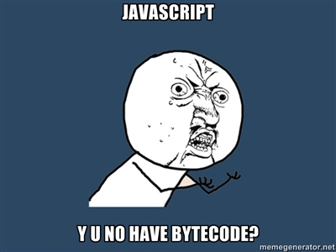
Compile in JS?

Slide 12
Issues
function arguments
closures
function declarations
named function expressions
performance

Slide 13
Direct vs indirect eval
Call from global
Call from local / renamed global
Function
setInterval and setTimeout

Slide 14
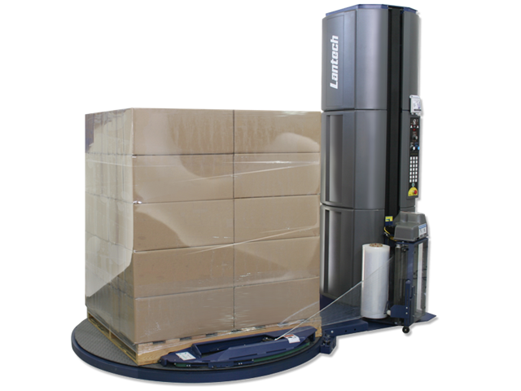
Basically

Slide 15
Open issues
Big:
Inserting new functions
Minor:
Variable clashes
Hard to explain

Slide 16
Code
http://github.com/qfox/recompiler

Slide 17

Questions?
qfox.nl | @kuvos

